Slide 1
AIT
~10 slides
Propose a design of the Electric Ground Support Equipment (EGSE);
Propose a design of the flatsat that will aid in the development of flight software and the verification of operations. Flatsat can be used for:
Test and verify all hardware interfaces
Verify all spacecraft modes and state transitions
Test and verify software commands and procedures
Validate Mission Operations commands and procedures
Validate power transmission for operating modes
Test for failure modes and recovery procedures
Validate ground segment protocols and communications functionality
Propose CubeSat test plan including safety and handling procedure
Present the laboratory environment for spacecraft integration and tests

Slide 2
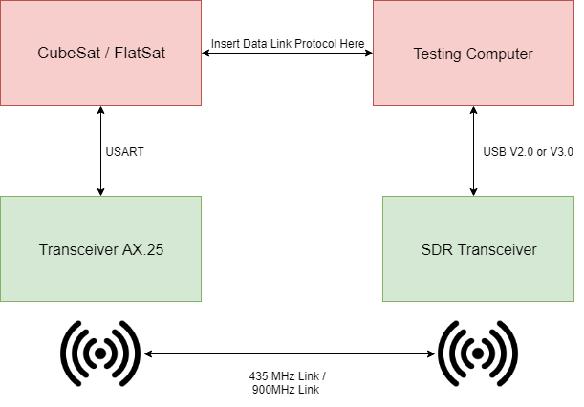
AIT
Electric Ground Support Equipment:
Goal: Design the equipment and software needed to test a CubeSat / FlatSat with little human interaction.

Slide 3
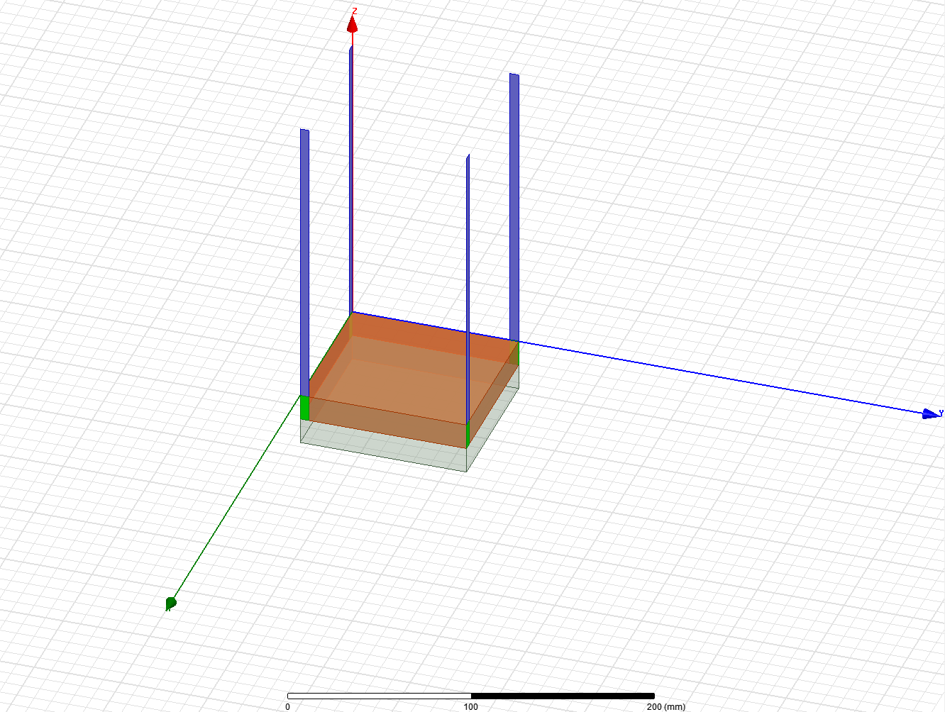
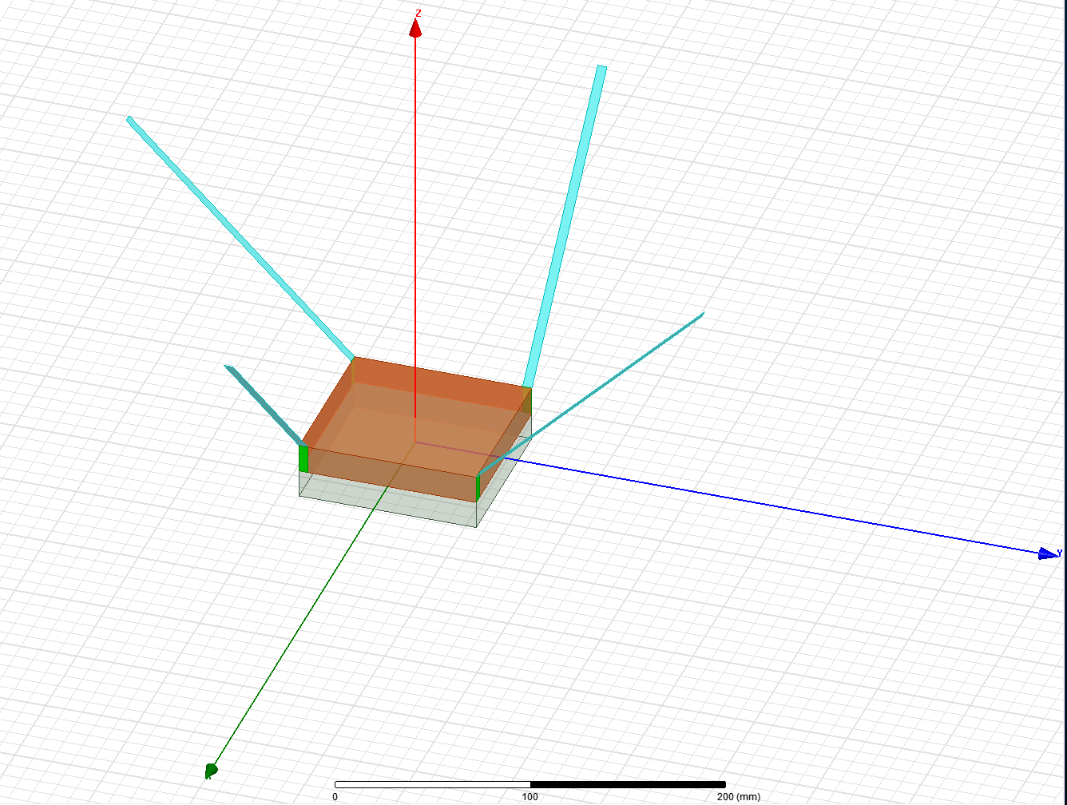
AIT
EGSP:
Acknowledged that antenna release mechanism testing is critical*
It also has moving parts and will require some human interaction for verification that it will NOT damage the surrounding components.
Heavy emphasis on testing starting mechanism when designed for maximum safety assurance*
The other components will be designed to be modularly tested.

Slide 4
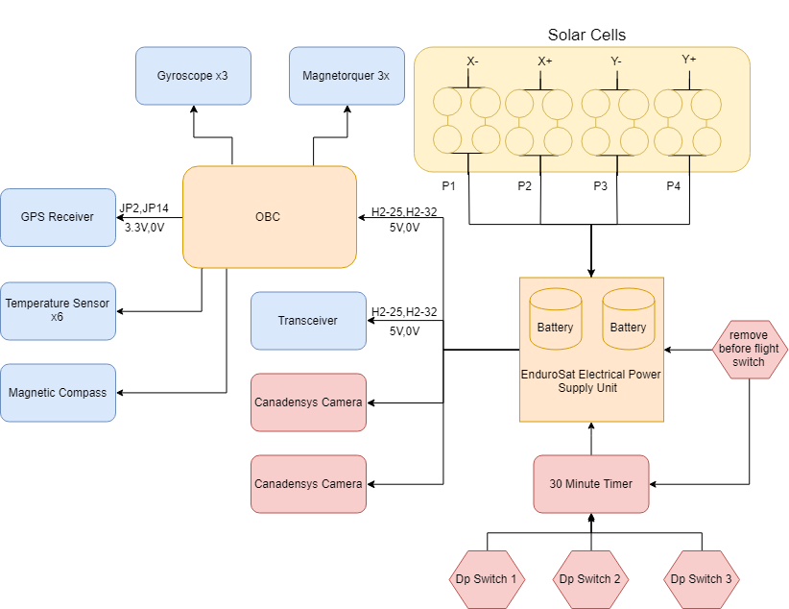
AIT
Red = Will Become Flight Hardware
Black = Can be cheaply prototyped (not flight hardware right away)

Slide 5
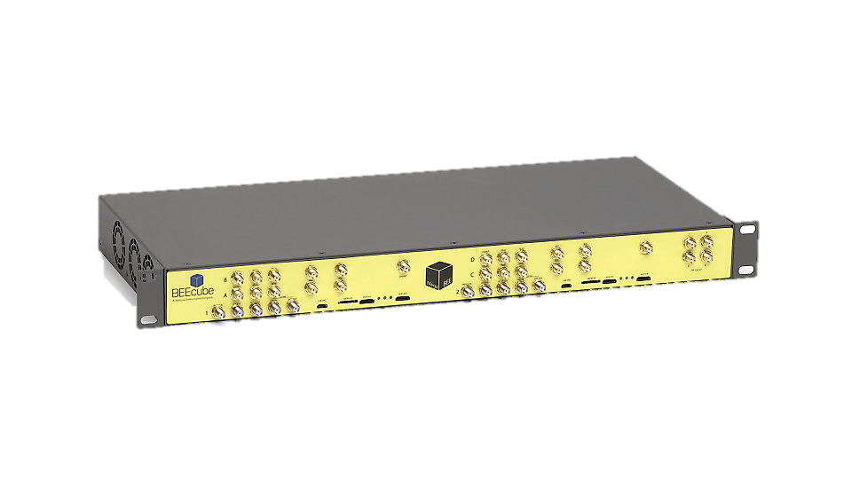
AIT
EGSP:
SDR Transceiver (USRP B210 if available)
SDR Transceiver (MegaBEE cube)
70MHz-6GHz
56MHz bandwidth per channel
23dBm output Power
-94dBm receiver sensitivity level
Software: HDL,Matlab/Simulink,C/C++/Python
USB V2.0 connection
SMA antenna connectors
FREE, Already in lab (good for rapid prototyping)
Notes:
Note that the USRP is going to be purchased but that will not stop our prototyping! I have asked jayshri and we are able to make use of the MegaBEE cube that we have in lab (we have other SDR’s as well)

Slide 6
AIT
CubeSat Test Plan:
Safety and Handling Procedures:
BBM:
Summer student work 2019 + Capstone 2018 prelim
Demonstration model:
FlatSat
Structural and Thermal Model:
Bus redesigned, Need to do another thermal + vibe test
Proto-Flight Model:
FlatSat will turn into it
Flight Model:
From Proto-Flight Model

Slide 7
AIT
People Resources:
CubeSat Club members during the year.
Will be started this year!!
Safety training, bringing up to speed on project
Assembly and Integration training
Extra hands on demonstration model under team leads
Capstone Teams:
Structural and Thermal model
Groundstation design
PCB Design for custom boards
Including inspection protocols, manufacturing plan and testing plan

Slide 8
AIT
People Resources:
Team Leads:
Individual subsystems
Develop a detailed testing plan if not done already.
Summer Students(2019):
Documentation is done (Github and Sharepoint)
Assembly instructions for CubeSat bus
Assembly instructions for assembling solar panels

Slide 9
AIT
Still to do:
EMI testing plan, requirements and procedure
Identify resources required
Custom board design + testing
Request For Deviation form for early turn on of camera
Timer circuit based on above decision
Antenna release mechanism and testing
Operations protocols and training with CubeSat club students

Slide 10
AIT
Laboratory Environments for Spacecraft Assembly:
What class of clean room necessary?
Is air handling necessary?
Options for rooms:
Thomson Engineering Building room 6
Optics Lab Spencer Engineering Building room 3025A
Western NanoFabrication Facility

